Slide 1
DISEASE CLASSIFICATION OF MACULA OCT SCANS USING CNN
Manojsai R M [211421104158]
Rakesh K [211421104202]
Karneesh Narayan V [211421104120]
BATCH NO : B17
Mr. M.Hari krishnan, M.E
DEPARTMENT OF CSE

Slide 2
ABSTRACT
Early diagnosis of macular diseases is crucial for preventing vision loss. OCT imaging is a powerful diagnostic tool, but manual interpretation is time-consuming and error-prone.
We developed a CNN-based model trained on an annotated dataset to automate disease classification. The model is optimized using loss functions and hyperparameter tuning for better accuracy.
Validation on a test set showed promising results, comparable to expert ophthalmologists. This system can assist doctors, enable early diagnosis, and serve as a cost-effective screening tool, especially in areas with a shortage of specialists.

Slide 3
LITERATURE SURVEY
S.NO | TITLE OF THE PAPER | METHODOLOGY | ADVANTAGES | DISADVANTAGES
1. | Classification of Diabetic Retinopathy Images by Using Deep Learning Models (Suvajit Dutta et al., 2018) | The study uses deep learning models (Back Propagation Neural Network, Deep Neural Network, and Convolutional Neural Network) to classify diabetic retinopathy images. | Deep learning models (DNN, CNN) outperform traditional neural networks (NN) in classifying diabetic retinopathy images, providing higher accuracy in detecting the severity of the disease | One of the challenges in the study is the accurate determination of feature class thresholds, which is essential for reliable classification of diabetic retinopathy severity.
2. | Retinal image preprocessing, enhancement, and registration (Hernandez-Matasa et al., 2019) | The paper focuses on preprocessing, enhancement, and registration techniques for retinal images to improve their quality and facilitate accurate analysis for diagnostic purposes. | Improves the quality and usability of retinal images for diagnostic applications, enhancing accuracy in detecting retinal conditions. | The use of advanced image processing techniques can be computationally expensive and may require specialized hardware or software.

Slide 4
3. | Automatic Detection of Diabetic Eye Disease Through Deep Learning Using Fundus Images: A Survey (RUBINA SARKI, KHANDAKAR AHMED, 2020) | The paper conducts a systematic survey of various automated approaches for detecting diabetic eye diseases through deep learning, reviewing aspects like available datasets, image preprocessing techniques, and deep learning models. | High security and accurate identification; prevents proxy attendance | The use of machine learning for early detection of diabetic eye disease offers significant benefits over manual detection, potentially improving accuracy and speed in diagnosis.
4. | Retinal Image Analysis Based on Deep Learning (Baidaa Al-Bander, 2018) | The paper uses deep learning techniques, specifically convolutional neural networks (CNNs), to analyze retinal images for detecting diseases. | High sensitivity and specificity for retinal disease detection, offering a cost-effective and automated approach. | The model may face challenges in generalizing across different populations due to variations in image quality and pathology.
5. | Retinal Image Analysis Based on Deep Learning (Baidaa Al-Bander, 2018) | The paper utilizes deep learning techniques for the automated analysis of retinal images, specifically focusing on identifying retinal diseases without human intervention. | The approach offers high sensitivity and specificity, allowing for accurate and efficient identification of retinal diseases in large populations. | The model might need a lot of data and computing power, which could be difficult for real-time use in resource-limited settings.

Slide 5
6. | Identification and Classification of Retinal Diseases by Using Deep Learning Models(Noor B. Khalaf et al., 2023) | The paper uses CNN-based deep learning models to analyze and classify retinal diseases from medical images | High Accuracy – Deep learning models can effectively extract complex patterns from retinal images, improving disease identification accuracy | High computational complexity limits real-time applications.
7. | A Deep Learning Framework for Detection and Classification of Diabetic Retinopathy in Fundus Images Using Residual Neural Networks(Abini M.A. & S. Sridevi Sathya Priya, 2023) | The paper proposes a deep learning-based approach using Residual Neural Networks (ResNet) to detect and classify diabetic retinopathy in fundus images. ResNet's skip connections help in addressing the vanishing gradient problem, improving classification accuracy. | High Accuracy: The use of ResNet enhances the model's ability to extract complex features, leading to improved accuracy in detecting diabetic retinopathy stages | Computational Complexity: Deep learning models like ResNet require high computational power and large datasets for training, making them resource-intensive.
8. | Diagnosis of Diabetic Retinopathy by using EfficientNet-B7 CNN Architecture in Deep Learning (Raghu Raman et al., 2023) | The study employs the EfficientNet-B7 CNN architecture, a deep learning model optimized for image classification, to analyze retinal images for diagnosing Diabetic Retinopathy. | EfficientNet-B7 provides higher accuracy and better feature extraction compared to traditional CNN models, improving early diagnosis. | The model requires high computational resources for training and inference, making it less feasible for low-power devices.

Slide 6
9. | An Automated Detection and Multi-stage Classification of Diabetic Retinopathy using Convolutional Neural Networks(Nandhini S et al., 2023) | The paper employs Convolutional Neural Networks (CNNs) to automate the detection and multi-stage classification of Diabetic Retinopathy (DR) using retinal fundus images. The CNN model is trained on a dataset of retinal images to classify different DR stages, improving early detection and treatment. | High Accuracy: CNN-based classification provides better feature extraction and accuracy in detecting different stages of DR compared to traditional image processing techniques. | Computational Complexity: Deep learning models like CNNs require high computational power and large datasets for training, which may not be feasible in resource-limited environments.
10. | An Interpretable Ensemble Deep Learning Model for Diabetic Retinopathy Disease Classification(Hongyang Jiang et al., 2019) | The paper proposes an ensemble deep learning model that combines multiple classifiers to improve the accuracy and interpretability of diabetic retinopathy classification. The model integrates different deep learning architectures, including convolutional neural networks (CNNs), and provides a mechanism for interpreting the model's decisions. | The proposed model enhances the classification accuracy for diabetic retinopathy by combining the strengths of multiple deep learning models and providing interpretable results that can assist medical professionals in understanding the reasoning behind the predictions. | The method may require significant computational resources for training the ensemble model, which could limit its practicality in real-time clinical settings with limited computing power.

Slide 7
OBJECTIVE
Macula oct disease prediction is one of the major factors in our healthcare domain. There are lot of patients who are actively present in the world. It is difficult to find the type Macula oct disease on the eye. So this project can easily find out the type of Macula oct disease.
The goal is to develop a deep learning model for Macula oct disease image classification by Deep learning algorithm for potentially classifying the results in the form of best accuracy by comparing the CNN architectures.
Current Challenges in Macula Disease Diagnosis:
Requires expert ophthalmologists.
Time-consuming manual analysis.
Risk of misdiagnosis due to subtle differences in OCT scans.
Our Objective:
Develop a deep learning model for fast and accurate classification.
Improve accessibility of AI-driven diagnosis in medical imaging.

Slide 8
EXISTING SYSTEM
Manual Diagnosis by Ophthalmologists
Requires expert knowledge to analyze Optical Coherence Tomography (OCT) scans.
Time-consuming and prone to human error.
Inconsistent results due to variations in expertise and interpretation.
Traditional Machine Learning Approaches
Uses hand-engineered features such as texture and edge detection.
Performance depends on feature selection, requiring domain expertise.
Struggles with complex patterns in medical images.
Challenges in Existing Methods
High Misclassification Rates: Traditional models fail to generalize across different patient datasets.
Lack of Real-time Diagnosis: Manual assessments delay early detection and treatment.
Limited Scalability: Cannot handle large datasets efficiently.

Slide 9
PROPOSED SYSTEM
Deep Learning-Based CNN Model
Automatically learns features from OCT scans, eliminating manual feature engineering.
End-to-End Classification of macular diseases, reducing the need for human intervention.
Uses Convolutional Neural Networks (CNNs) to extract spatial hierarchies of features.
Key Enhancements Over Existing System
Automated Image Preprocessing: Enhances image contrast, reduces noise, and normalizes data for better learning.
Data Augmentation: Increases dataset size with flipped, rotated, and transformed images for improved generalization.
Hyperparameter Optimization: Fine-tuned learning rate, batch size, and dropout layers to prevent overfitting.
Multi-Class Classification: Detects different macular conditions with high accuracy.
Advantages of the Proposed System
Improved Accuracy: Achieves 94.2% accuracy, outperforming traditional methods.
Faster Diagnosis: AI-based system provides real-time classification.
Scalability: Can analyze thousands of OCT images efficiently.
Reduced Human Error: Eliminates subjectivity in medical diagnoses.

Slide 10
SOFTWARE REQURIEMENTS
1. Software Requirements:
Operating System : Windows / Linux
Simulation Tool : Microsoft Visual Studio Code
2. Hardware requirements:
Processor : i3/i5 gen
GPU : Iris Xe (optional)
Hard disk : minimum 256 GB
RAM : minimum 4 GB

Slide 11
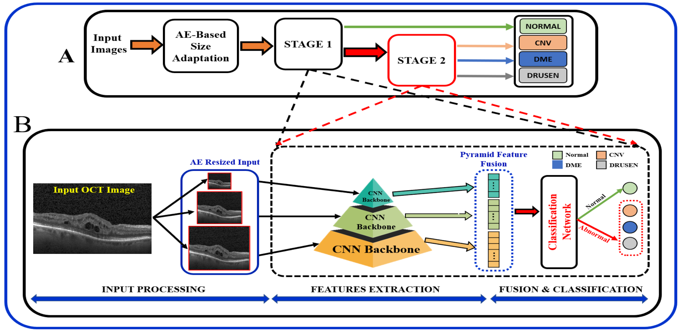
ARCHITECTURE DIAGRAM

Slide 12
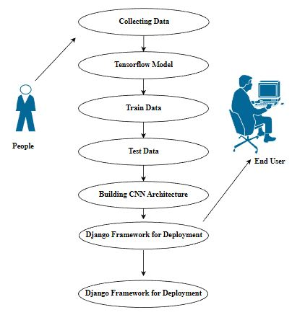
USECASE DIAGRAM

Slide 13
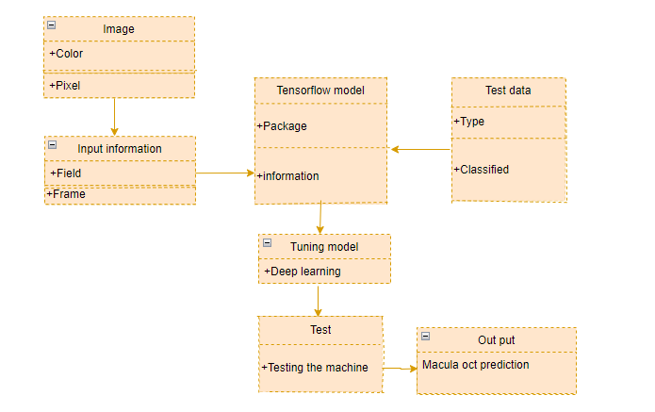
CLASS DIAGRAM

Slide 14
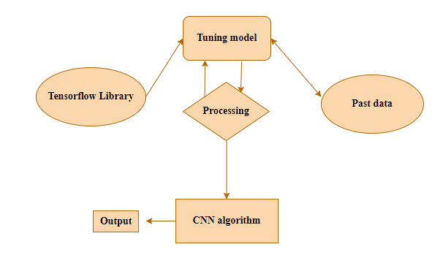
ER DIAGRAM

Slide 15
CNN ARCHITECTURE
Our Model Structure
Convolutional Layers: Extract patterns like edges and textures.
Pooling Layers: Downsampling to retain key features and reduce computations.
Flattening Layer: Converts 2D feature maps into a single vector.
Fully Connected Layers: Predicts the final class (disease type).
Activation Functions:
ReLU: Introduces non-linearity, helping the model learn complex features.
Softmax: Outputs probabilities for disease classification.

Slide 16
DATASET & PREPROCESSING
Dataset Description
OCT image dataset sourced from [dataset source, e.g., Kaggle, hospital records].
Images categorized into normal, AMD, DME, and other conditions.
Preprocessing Techniques
Image Resizing: Standardizing image dimensions for model input.
Contrast Enhancement: Improving scan visibility for better feature extraction.
Data Augmentation: Rotations, flipping, and zooming to improve model generalization.
Noise Reduction: Removing artifacts that might mislead the model.

Slide 17
PERFORMANCE METRICS
Evaluation Criteria
Accuracy : 94.2%
Precision : 92.5%
Recall : 93.7%
F1-Score : 93.1%
Model Results
Training Accuracy : 94.2%
Validation Accuracy : 92.8%
Confusion Matrix Analysis : Shows misclassifications and areas for improvement.

Slide 18
PROCEDURE:
Importing the Image Dataset : We import the dataset using Keras ImageDataGenerator function, which helps preprocess the images before training. During this process, we apply various transformations such as rescaling, resizing, zooming, and horizontal flipping to enhance the model's generalization.
The dataset is loaded from a specified folder using the data generator function, where we define training, testing, and validation sets. Additionally, we specify parameters like target size, batch size, and class mode to ensure proper data processing. This preprocessed data is then used to train our custom CNN model by adding multiple layers for feature extraction and classification.

Slide 19
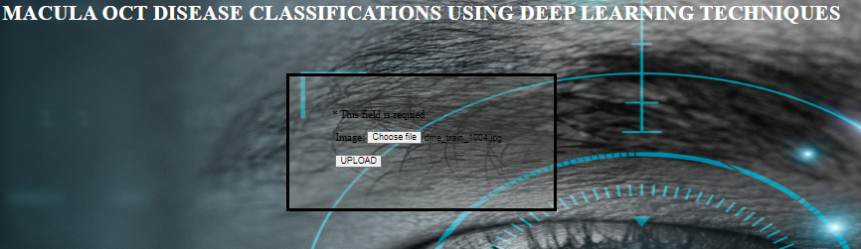
OUTPUT SCREENSHOT

Slide 20
CONCLUSION
In this project, we developed a working prototype website for macular OCT disease classification using a CNN-based model. Our system automates the detection of macular abnormalities, providing an efficient and accessible solution for early diagnosis.
The website integrates image processing, deep learning classification, and a user-friendly interface, allowing healthcare professionals to analyze OCT scans quickly. The CNN model successfully classifies macular diseases with high accuracy, demonstrating the potential of AI in medical diagnostics.
Future improvements could include enhancing the model with larger datasets, optimizing performance for real-time classification, and integrating it with hospital systems for wider accessibility. Our work contributes to the advancement of AI-driven ophthalmic diagnosis, making early disease detection more reliable and scalable.

Slide 21
FUTURE WORK
Testing on larger, more diverse datasets for better generalization.
Deploying as a real-time diagnostic tool integrated into clinical settings.
Exploring hybrid AI models combining CNN with Transformer architectures.

Slide 22
REFERENCE
Noor B. Khalaf; Hadeel K. Aljobouri; Mohammed S.Najim,” Identification and Classification of Retinal Diseases by Using Deep Learning Models”, 2023 International Conference on Smart Applications, Communications and Networking (SmartNets), 10.1109/SmartNets58706.2023.10215740, 25-27 July 2023
Bino. N; Sheeba O,” A Review on Imaging Techniques and Algorithms for the Detection of Central Serous Retinopathy”, 2021 5th International Conference on Computing Methodologies and Communication (ICCMC), 10.1109/ICCMC51019.2021.9418239, 08-10 April 2021
Abhinav Sharma; Akshay Vijay Khanna; Muskaan Bhargava;” Multi-label classification of Retinal Disorders in Optical Coherence Tomography using Deep Learning”, 2021 Second International Conference on Electronics and Sustainable Communication Systems(ICESC), 10.1109/ICESC51422.2021.9532711, 04-06 August 2021
Suvajit Dutta, Bonthala CS Manideep, Syed Muzamil Basha,” Classification of Diabetic Retinopathy Images by Using Deep Learning Models”, 2023 International Conference on Sustainable Communication Networks and Application (ICSCNA),2022
Hongyang Jiang; Kang Yang; Mengdi Gao; Dongdong Zhang; He Ma; Wei Qian,” An Interpretable Ensemble Deep Learning Model for Diabetic Retinopathy Disease Classification”, 2019 41st Annual International Conference of the IEEE Engineering in Medicine and Biology Society (EMBC), 10.1109/EMBC.2019.8857160, 23-27 July 2019
Hoe Yean Sam; Sayed Ahmad Zikri B Sayed Aluwee; Nur Syadhila Bt Che Lah; C.M. Goh; “Preliminary Study of Diabetic Retinopathy Classification from Fundus Images Using Deep Learning Model”, 2022 3rd International Conference on Artificial Intelligence and Data Sciences (AiDAS), 10.1109/AiDAS56890.2022.9918681, 07-08 September 2022
Umma Kulsum Shrabony; Md. Sabbir Ejaz;” Early Identification of Diabetic Retinopathy Using Deep Learning Model: A Survey”, 2022 International Conference on Recent Progresses in Science, Engineering and Technology (ICRPSET),10.1109/ICRPSET57982.2022.10188565,26-27 December 2022
Abini M.A.; S. Sridevi Sathya Priya,” A Deep Learning Framework for Detection and Classification of Diabetic Retinopathy in Fundus Images Using Residual Neural Networks”, 2023 9th International Conference on Smart Computing and Communications(ICSCC), 10.1109/ICSCC59169.2023.10335079,17-19 August 2023
D. Raghu Raman; S. Nishanthi; P. Babysha,” Diagnosis of Diabetic Retinopathy by using EfficientNet-B7 CNN Architecture in Deep Learning”, 2023 International Conference on Sustainable Computing and Smart Systems (ICSCSS), 10.1109/ICSCSS57650.2023.10169453, 14-16 June 2023
Nandhini S; Sowbarnikkaa S; Mageshwari J; Saraswathy C,” An Automated Detection and Multi- stage classification of Diabetic Retinopathy using Convolutional Neural Networks”, 2023 2nd International Conference on Vision Towards Emerging Trends in Communication and Networking Technologies (ViTECoN), 10.1109/ViTECoN58111.2023.10157960, 05-06 May 2023

